Slide 1

18MAB302T-Discrete Mathematics for Engineers UNIT 3

Slide 2
Contents
Proposition and logical operators
Truth tables
Tautology , Contradiction and Contingency
Equivalences
Implications
Inference theory of propositions

Slide 3
Proposition or Statement
A declarative sentence which is true or false but not both is called a proposition
Sentences which are exclamatory, interrogative or imperative in nature are not propositions
Lower case letters are used to denote propositions

Slide 4
Examples of propositions are
Chennai is a city
2+2=3
Examples of not a proposition are
What a beautiful day!
Shut the door
What time is it?

Slide 5
If a proposition is true , we say that the truth value of the proposition is true, denoted as T
If a proposition is false , we say that the truth value of the proposition is false, denoted as F
Atomic/ Primary/Primitive statement is a statement which does not contain any connectives

Slide 6
Compound or Molecular statement is a statement which is constructed by combining one or more statements using connectives
There are 5 connectives or logical operators
Conjunction, disjunction, negation, conditional and biconditional

Slide 7
Conjunction Ʌ
When p and q are any two propositions, the proposition “p and q” is denoted by pɅq and is called conjunction of p and q which is a compound statement that is true when p and q are true and is false otherwise. Truth Table is
p | q | pɅq
T | T | T
T | F | F
F | T | F
F | F | F

Slide 8
Disjunction ᴠ
When p and q are any two propositions, the proposition “p or q” is denoted by p ᴠ q and is called disjunction of p and q which is a compound statement that is false when p and q is false and is true otherwise. Truth Table is
p | q | pᴠq
T | T | T
T | F | T
F | T | T
F | F | F

Slide 9
Negation ¬
Given a proposition p, negation of this proposition is ¬p. ¬ is read as “It is not the case that” or “It is false that.
Example: p Chennai is a city
¬p Chennai is not a city
Truth table is
p | ¬p
T | F
F | T

Slide 10
Conditional→
If p and q are any two propositions, the compound proposition “if p then q” is denoted by p→q is called a conditional proposition, which is false when p is true and q is false and is true otherwise, p is hypothesis and q is conclusion. Truth table is
p | q | p→q
T | T | T
T | F | F
F | T | T
F | F | T

Slide 11
Example of conditional
If I get up at 5 AM, I will go for a walk
If I get up at 5 AM, I will not go for a walk
If I have not got up by 5 AM, I may or may not not go for a walk
( the contract is not violated , so p→q is true)

Slide 12

biconditional↔
If p and q are any two propositions, the compound proposition “p if and only if q” is denoted by p↔qis called a biconditionalproposition, which is true when p and q have the same truth value and is false otherwise, Eg. $n$ is even if and only if $n^{2}$is even
p | q | p↔q
T | T | T
T | F | F
F | T | F
F | F | T

Slide 13
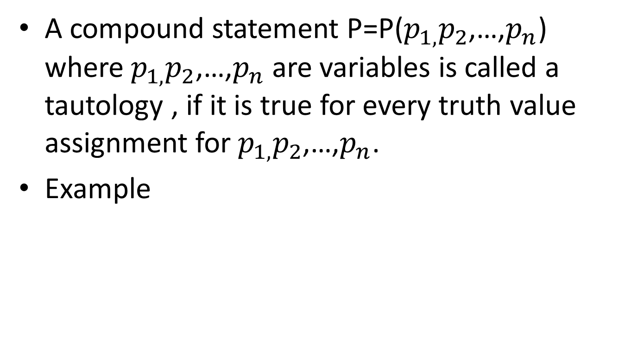
Tautology
p | ¬p | pᴠ¬p
T | F | T
F | T | T

Slide 14
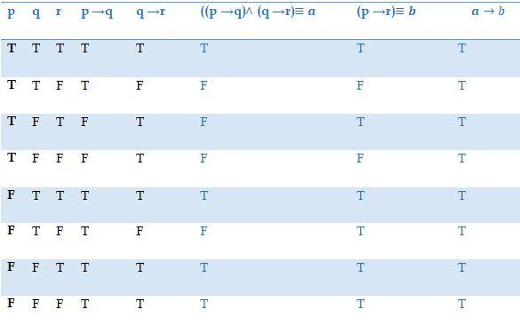
2. Show that ((p →q) ˄ (q →r)) → (p →r) is a tautology.

Slide 15
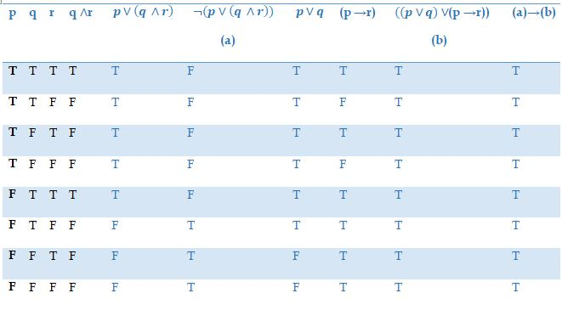
3. Show that the following compound proposition is a tautology. ¬(p∨(q ∧r)) → ((p∨q)˄(p →r))

Slide 16
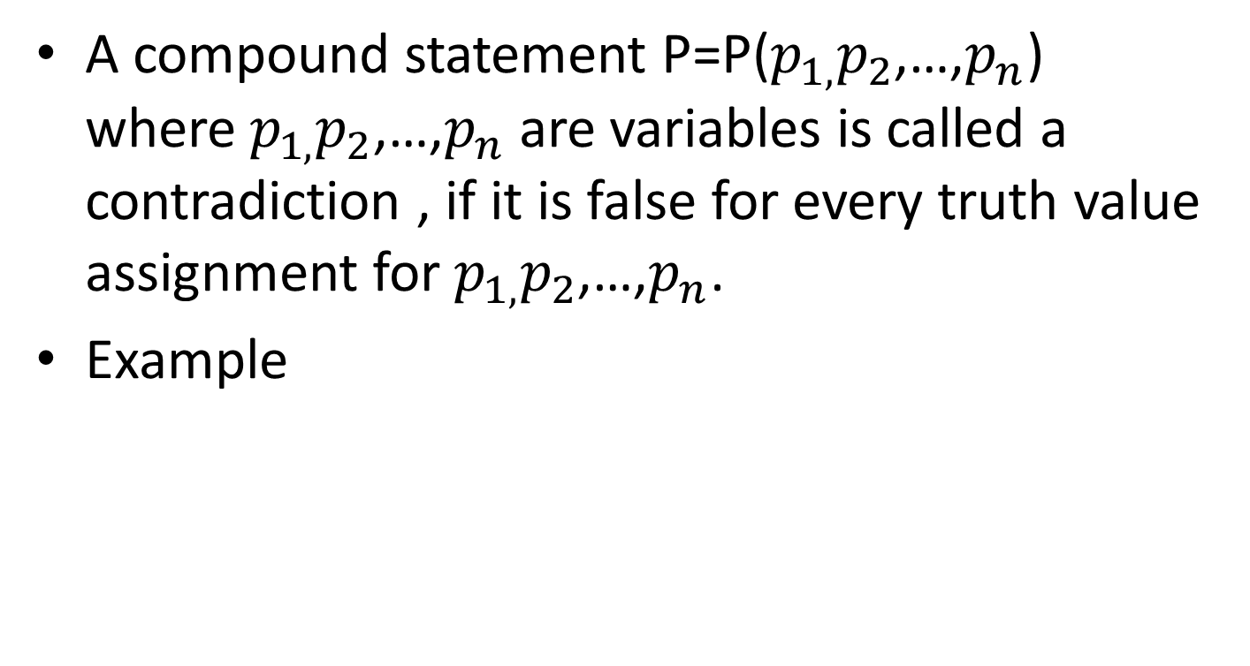
Contradiction
A compound statement P=P($p_{1,}p_{2}$,…,$p_{n}$) where $p_{1,}p_{2}$,…,$p_{n}$ are variables is called a contradiction , if it is false for every truth value assignment for $p_{1,}p_{2}$,…,$p_{n}$.
Example
p | ¬p | pɅ¬p
T | F | F
F | T | F

Slide 17
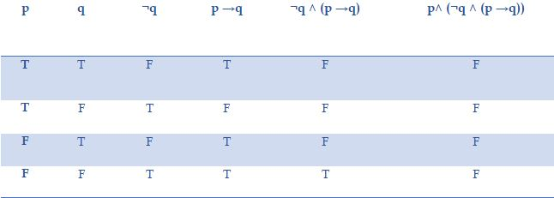
2. Show that the following Compound Proposition is a contradiction. p ˄ (¬q ˄ (p → q))

Slide 18
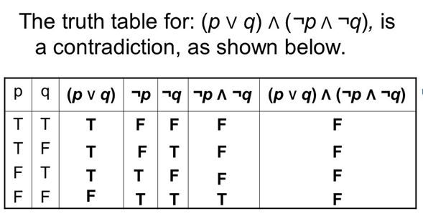
Example 3

Slide 19
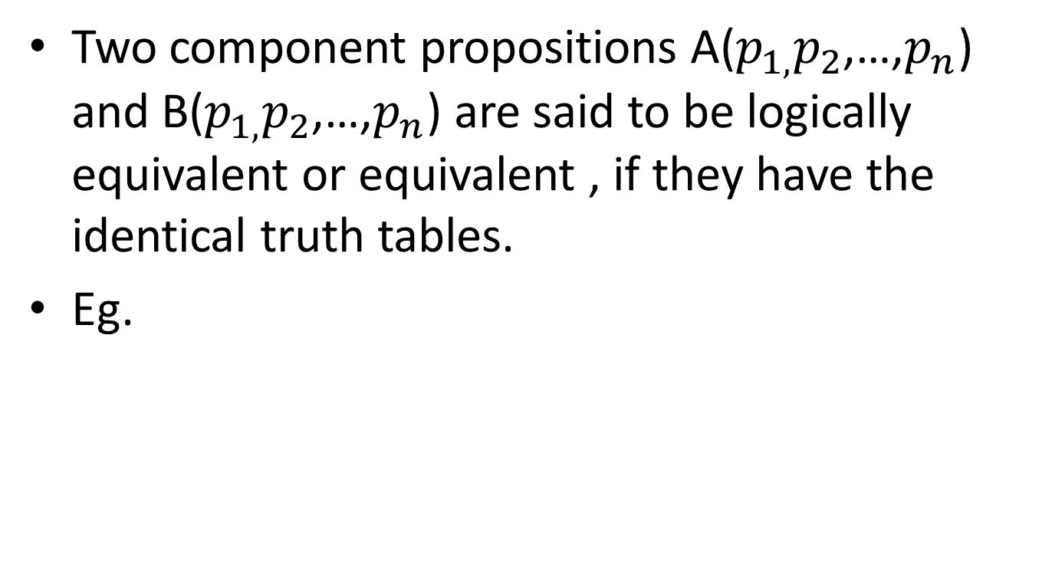
Equivalence of propositions A≡B
Two component propositions A($p_{1,}p_{2}$,…,$p_{n}$) and B($p_{1,}p_{2}$,…,$p_{n}$) are said to be logically equivalent or equivalent , if they have the identical truth tables.
Eg.
p | q | pᴠq | ¬(pᴠq) | ¬p | ¬q | ¬pɅ¬q
T | T | T | F | F | F | F
T | F | T | F | F | T | F
F | T | T | F | T | F | F
F | F | F | T | T | T | T

Slide 20
Note: Already p↔q is true whenever A and B have same true vales. So p↔q is a tautology when A and B are equivalent. Conversely A≡B when p↔q is a tautology. Example is
p | q | p→q | ¬p | ¬pᴠq | (p↔q) ↔(¬pᴠq)
T | T | T | F | T | T
T | F | F | F | F | T
F | T | T | T | T | T
F | F | T | T | T | T

Slide 21
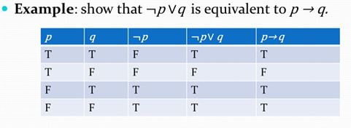

Slide 22
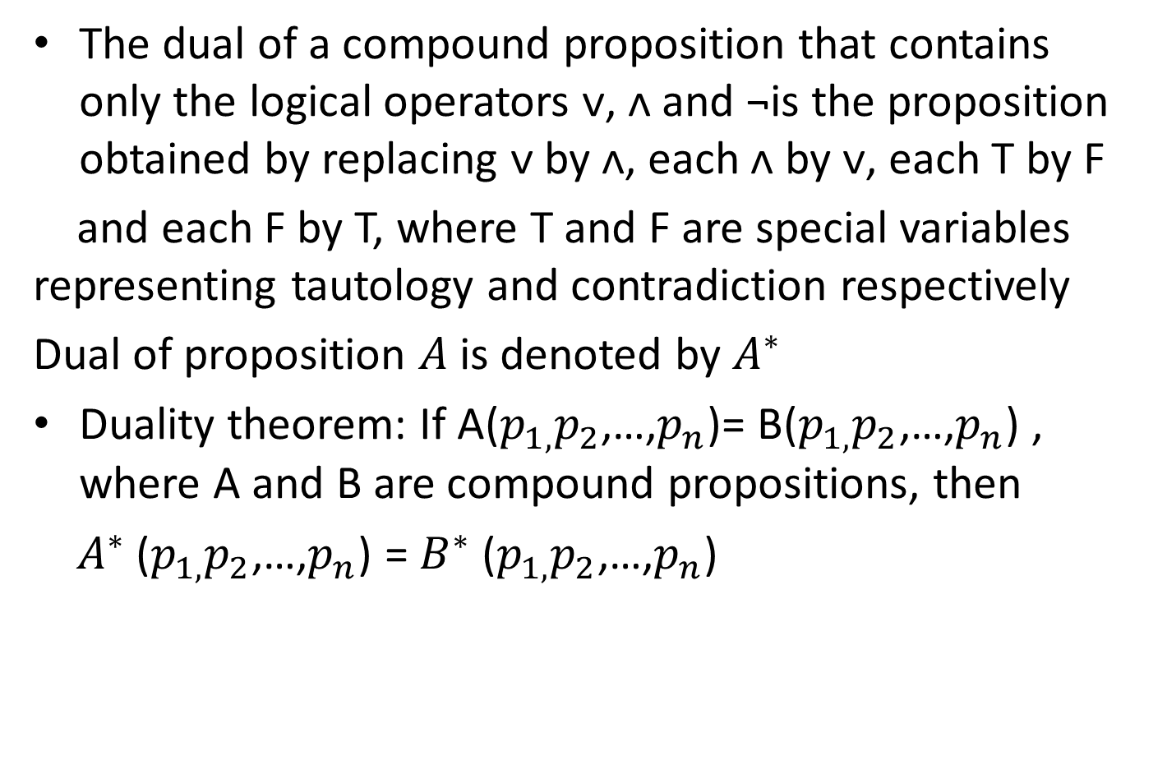
Duality Law
The dual of a compound proposition that contains only the logical operators ᴠ, ᴧ and ¬is the proposition obtained by replacing ᴠ by ᴧ, eachᴧ by ᴠ, each T by F
and each F by T, where T and F are special variables representing tautology and contradiction respectively
Dual of proposition $A$is denoted by $A^{∗}$
Duality theorem: If A($p_{1,}p_{2}$,…,$p_{n}$)= B($p_{1,}p_{2}$,…,$p_{n}$) , where A and B are compound propositions, then
$A^{∗}$ ($p_{1,}p_{2}$,…,$p_{n}$) = $B^{∗}$ ($p_{1,}p_{2}$,…,$p_{n}$)

Slide 23
Examples
1. write the dual of p∨¬q
Ans: p∧¬q
2. write the dual ofp∧(q∨(r∧T))
Ans: p∨(q∧(r∨F))
3. write the dual of (p∧¬q)∨(q∧F)
Ans:(p∨¬q)∧(q∨T)
4. write the dual of p ∧ q)∨ (¬p ∨ q)∨ F
Ans: (p ∨ q)∧ (¬p ∧ q)∧T

Slide 24
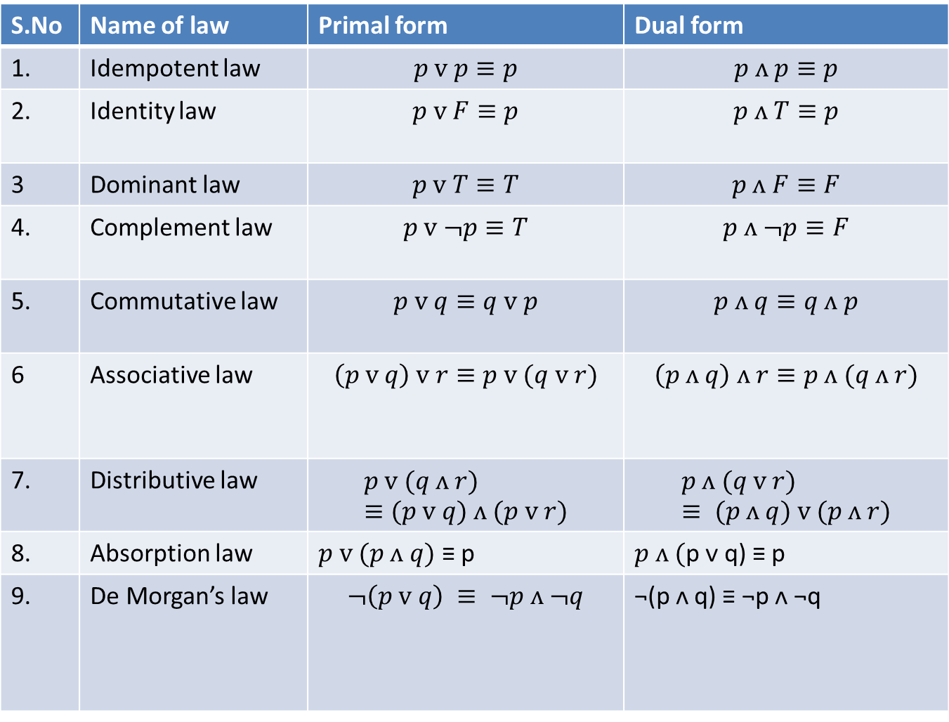
Table1:Laws of Algebra of propositions
S.No | Name of law | Primal form | Dual form
1. | Idempotent law | $$p ᴠ p≡p$$ | $$p ᴧ p≡p$$
2. | Identity law | $$p ᴠ F≡p$$ | $$p ᴧ T≡p$$
3 | Dominant law | $$p ᴠ T≡T$$ | $$p ᴧ F≡F$$
4. | Complement law | $$p ᴠ ¬p≡T$$ | $$p ᴧ ¬p≡F$$
5. | Commutative law | $$p ᴠ q≡q ᴠ p$$ | $$p ᴧ q≡q ᴧ p$$
6 | Associative law | $$\left(p ᴠ q\right) ᴠ r≡p ᴠ (q ᴠ r)$$ | $$\left(p ᴧ q\right) ᴧ r≡p ᴧ (q ᴧ r)$$
7. | Distributive law | $$p ᴠ (q ᴧ r)≡(p ᴠ q) ᴧ (p ᴠ r)$$ | $$p ᴧ (q ᴠ r) ≡ (p ᴧ q) ᴠ (p ᴧ r)$$
8. | Absorption law | $p ᴠ (p ᴧ q)$ ≡ p | $p ᴧ ($p ᴠ q) ≡ p
9. | De Morgan’s law | $$¬\left(p ᴠ q\right) ≡ ¬p ᴧ ¬q$$ | ¬(p ᴧ q) ≡ ¬p ᴧ ¬q

Slide 25
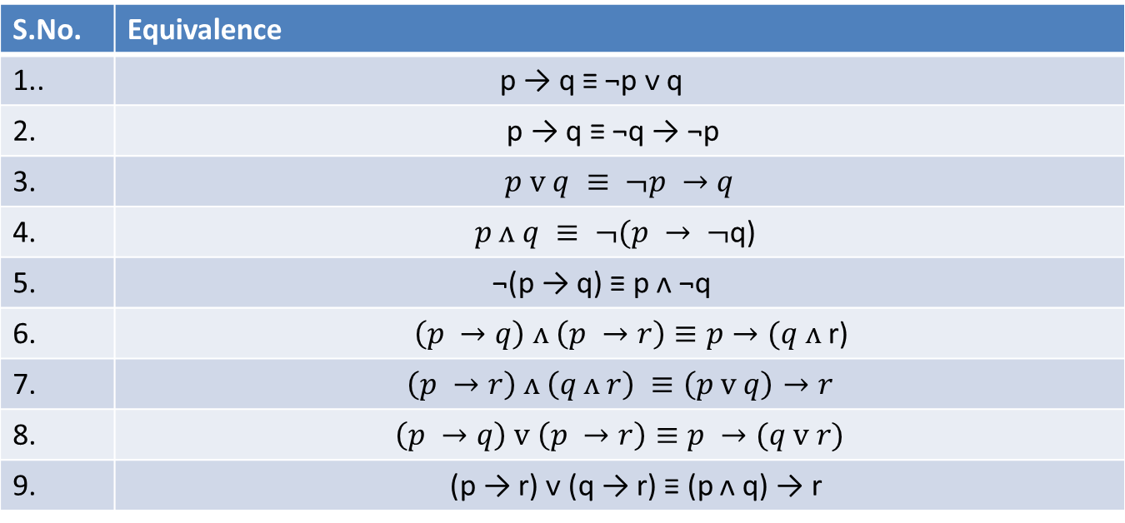
Table 2: Equivalences involving Conditionals
S.No. | Equivalence
1.. | p → q ≡ ¬p ᴠ q
2. | p → q ≡ ¬q → ¬p
3. | $$p ᴠ q ≡ ¬p →q$$
4. | $p ᴧ q ≡ ¬(p → ¬$q)
5. | ¬(p → q) ≡ pᴧ ¬q
6. | $\left(p →q\right) ᴧ \left(p →r\right)≡p→(q ᴧ$ r)
7. | $$\left(p →r\right) ᴧ \left(q ᴧ r\right) ≡\left(p ᴠ q\right)→r$$
8. | $$\left(p →q\right) ᴠ \left(p →r\right)≡p →(q ᴠ r)$$
9. | (p → r) ᴠ (q → r) ≡ (p ᴧ q) → r

Slide 26
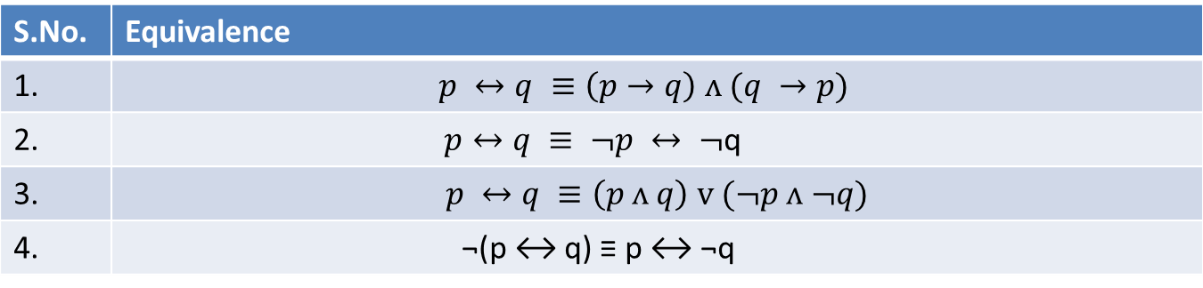
Table 3: Equivalences involving biconditionals
S.No. | Equivalence
1. | $$p ↔q ≡\left(p→q\right) ᴧ (q →p)$$
2. | $p↔q ≡ ¬p ↔ ¬$q
3. | $$p ↔q ≡\left(p ᴧ q\right) ᴠ (¬p ᴧ ¬q)$$
4. | ¬(p ↔ q) ≡ p ↔ ¬q

Slide 27
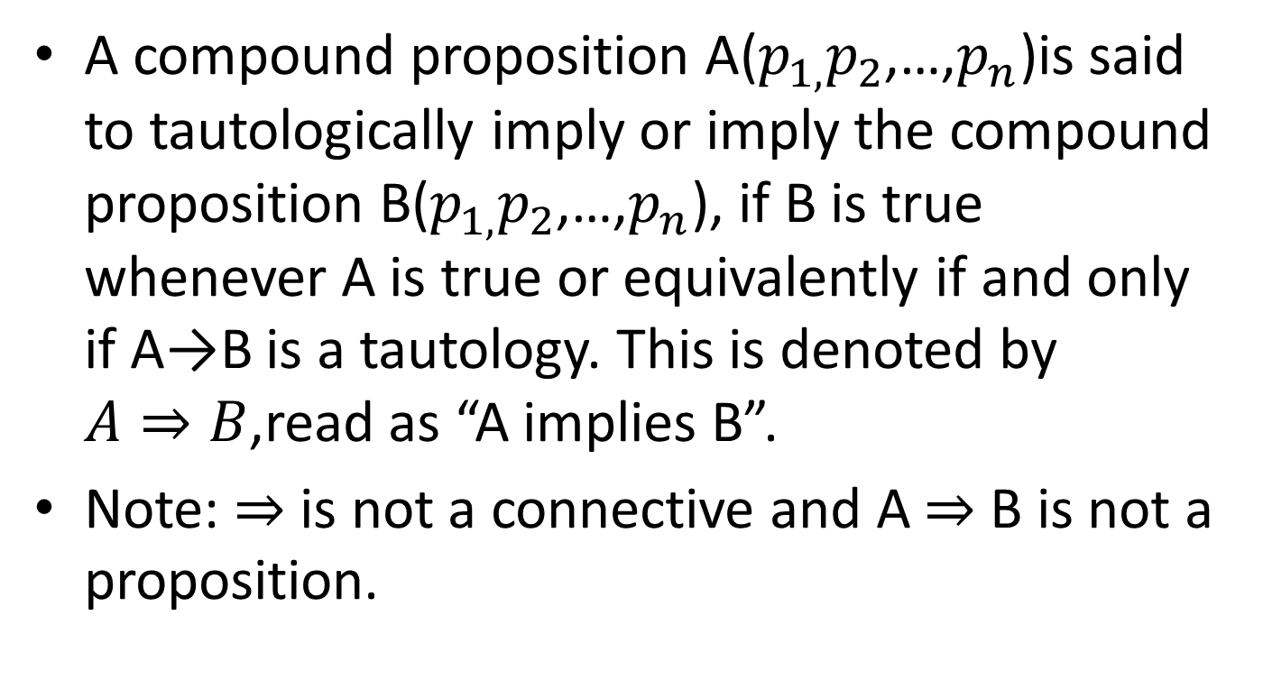
Tautological Implication
A compound proposition A($p_{1,}p_{2}$,…,$p_{n}$)is said to tautologically imply or imply the compound proposition B($p_{1,}p_{2}$,…,$p_{n}$), if B is true whenever A is true or equivalently if and only if A→B is a tautology. This is denoted by $A⇒B$,read as “A implies B”.
Note: $⇒$ is not a connective and A $⇒$ B is not a proposition.

Slide 28
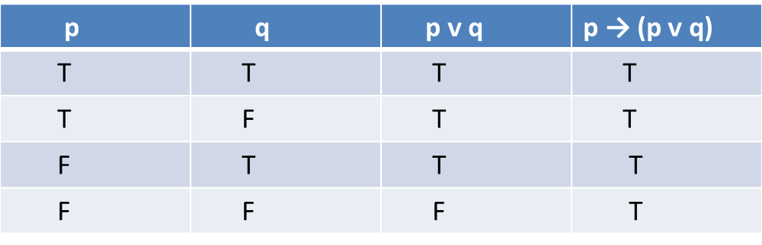
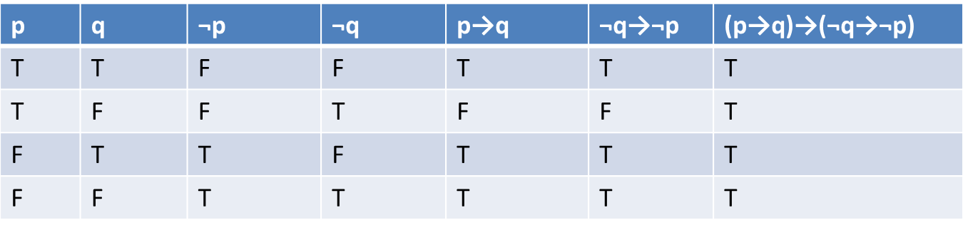
Example problems of implication
Show that (i) p ⇒ (p ᴠ q) (ii) (p→q) ⇒ (¬q→¬p)
(i)
(ii)

Slide 29
Table 4: Implications
S.No. | Implication
1 | p ᴧ q ⇒ p
2 | p ᴧ q ⇒ q
3 | p ⇒ p ᴠ q
4 | ¬p ⇒ p → q
5 | q ⇒ p → q
6 | ¬(p → q) ⇒ p
7 | ¬(p → q) ⇒ ¬q
8 | p ᴧ (p → q) ⇒ q
9 | ¬q ᴧ (p → q) ⇒ ¬p
10 | ¬p ᴧ (p ᴠ q) ⇒ q
11 | (p → q) ᴧ (q → r) ⇒ p → r
12 | (p ᴠ q) ᴧ (p → r) ᴧ (q → r) ⇒ r

Slide 30
Problem 1
Without using truth tables, prove that
p → (q → p) ≡ ¬p → (p → q)
Solution:
p → (q → p) ≡ ¬p ᴠ (q → p)
≡ ¬p ᴠ (¬q ᴠ p )
≡¬q ᴠ (p ᴠ ¬p), by commutative and
associative laws
≡ ¬p ᴠ T, by complement law
≡ T ,by dominant law (1)

Slide 31
¬p → (p → q) ≡ p ᴠ (p → q),by (1) of Table 1.10
≡ p ᴠ (¬p ᴠ q), by (1) of Table 1.10
≡ (p ᴠ ¬p) ᴠ q, by associative law
≡ T ᴠ q, by complement law
≡ T, by dominant law, (2)
From (1) and (2), the result follows.

Slide 32
Problem 2
Prove the following implications without using truth tables:
((p ᴠ ¬p) → q) → ((p ᴠ ¬p) → r) ⇒ q → r
Solution:
[((p ᴠ ¬p) →q) → ((p ᴠ ¬p) →r)] → (q →r)
≡ [(T → q) → (T → r)] → (q → r)
≡ [(F ᴠ q) → (F ᴠ r)] → (q → r)
≡ (q → r) →(q → r)
≡ T

Slide 33
Unit – 3 Theory of Inference
OUTLINE
Introduction
Truth table Technique
Examples
Rules of Inference
Direct Method
Indirect Method
Inconsistency
Conditional Proof

Slide 34
Introduction
Inference Theory is concerned with the inferring of a conclusion from certain assumptions called premises by applying certain principles of reasoning called Rules of Inference.
When a conclusion derived from a set of premises by using rules of inference, the process of such derivation is called Formal Proof.

Slide 35
Truth table Technique
A Conclusion C is said to follow from a set of premises H₁, H₂, …..H_{n} if H₁ ∧ H₂ ∧ …… ∧ H_{n}⇒ C
Problem 1 Consider H₁ : ¬ P , H₂ : P∨ Q ⇒ C : Q
P | Q | H₁ : ¬ P | H₂ : P∨ Q | C : Q
T | T | F | T | T
T | F | F | T | F
F | T | T | T | T
F | F | T | F | F
H₁ and H₂ are true only in the 3rd row of the above table, in which case Conclusion C is also true .Hence the conclusion is valid

Slide 36
Problem 2 If two sides of a triangle are equal, then two opposite angles are equal. Two sides of a triangle are not equal. Therefore the opposite angles are not equal.
P : Two sides of a triangle are equal. Q: The two opposite angles are equal H₁ : P→Q, H₂ : ¬ P ⇒ C : ¬ Q
P | Q | H₁ : P→Q | H₂ : ¬ P | C : ¬ Q
T | T | T | F | F
T | F | F | F | T
F | T | T | T | F
F | F | T | T | T

Slide 37
Conclusion:
H₁ and H₂ are true in the 3rd and 4th row of the above table,
but Conclusion C is different for the 3rd and 4th row . Hence
the conclusion is not a valid conclusion.
Note:
The truth table technique becomes tedious if the premises
contain a large number of variables

Slide 38
Rules of Inference
Rule P : A premise may be introduced at any step in the derivation.
Rule T: A formula S may be introduced in the derivation, if S is tautologically implied by one or more preceding formula in the derivation.
contd…….

Slide 39
Rules of Inference
S. No. | Rule in tautological form | Name of the rule
1. | (P∧Q)→P (P∧Q)→Q | simplification
2. | P→(P∨Q) Q→(P∨Q) | Addition
3. | P,Q→(P∧Q) | Conjunction
4. | (P, (P→Q))→Q | Modus Ponens
5. | (¬Q ∧(P→Q))→ ¬ P | Modus Tollens
6. | ((P→Q),(Q→R))→(P→R) | Hypothetical Syllagism
7. | ((P∨Q), ¬P) →Q | Disjunctive Syllagism
8. | ((P∨Q), (P→R),(Q→R)) →R | Dilemma

Slide 40
Direct Method
From the given statement, identify the premises and conclusion. Conclusion is obtained with the help of premises by using the rules of inference .

Slide 41
Problem 1 If it rains heavily, then travelling will be difficult. If students arrive on time, then travelling was not difficult. They arrived on time. Therefore, it did not rain heavily.
Solution :
P : It rains heavily
Q: Travelling is difficult
R: Students arrived on time.
Premises: P →Q, R→¬Q and R ⇒ Conclusion C: ¬ P

Slide 42
Stage | Premises | Rules
(1) | P→Q | Rule P
(2) | ¬ Q→ ¬ P | Rule T, (1), Contra positive
(3) | R → ¬ Q | Rule P
(4) | R → ¬ P | Rule T, (3),(2), Hypothetical Syllagism
(5) | R | Rule P
(6) | P | Rule T, (4),(5) and Modus Ponens

Slide 43
Problem 2 Construct an argument using rules of inference to show that the hypothesis:
Radha Works hard. If Radha works hard, then she is a
dull girl and if Radha is a dull girl, then she will not
get the job imply the conclusion Radha will not get
the job.
Solution /* Step1: Name the Sentences in the question by using capital letters */
R: Radha works hard
D: Radha is a dull girl
J: She will not get the job

Slide 44
Step 2 / * construct the premises . Identify the conclusion */
Sentence | Premise
Radha Works hard | H₁ : R
If Radha works hard, then she is a dull girl | H₂ : R→ D
If Radha is a dull girl, then she will not get the job | H₃ : D→ J
Imply the conclusion, Radha will not get the job | C : J

Slide 45
Stage | Premises | Rules
(1) | R | Rule P
(2) | R→ D | Rule P
(3) | D | Rule T, (1),(2) and Modus Ponens
(4) | D → J | Rule P
(5) | J | Rule T, (3),(4) and Modus Ponens
Thus we have derived the conclusion C using the given premises H_{1 ,} H_{2 ,}H₃

Slide 46
Problem 3 It is not sunny this afternoon and it is colder than yesterday. We will go to the playground only if it is sunny. If we do not go to the ground then we will go to a movie. If we go to a movie then we will return by sunset lead to the conclusion: we will return home by sunset.
Solution
P: It is sunny this afternoon.
Q: It is colder than yesterday.
R: We will go to the playground.
S: We will go to a movie.
T: We return home by sunset.
The premises are ¬ P∧Q, R→P, ¬ R → S, S → T
Conclusion C: T

Slide 47
Stage | Premises | Rules
1 | ¬ R→ S | Rule P
2 | S →T | Rule P
3 | ¬ R→T | Rule T , (1), (2) Hypothetical syllogism
4 | ¬P ∧ Q | Rule P
5 | ¬ P | Rule T , (4), simplification
6 | R → P | Rule P
7 | ¬S→ R | Rule T ,(1), Contra positive
8 | ¬ S→P | Rule T , (6), (7), Hypothetical syllagism
9 | ¬ P→ S | Rule T ,(8) ,Contrapositive
10 | S | Rule T (5), (9), Modus Ponens
11 | T | Rule T (2), (10), Modus Ponens.

Slide 48
Problem 4: Prove the following using direct method: P ∨ Q, P → R, Q → S ⇒ S ∨ R
Stage | Premises | Rules
1 | P ∨ Q | Rule P
2 | ∼P →Q | Rule T, (1), Equivalence
3 | Q → S | Rule P
4 | ∼P→S | Rule T, (2), (3) Hypothetical syllogism
5 | P → R | Rule P
6 | ∼S→ P | Rule T, (4), Contra positive
7 | ∼S→R | Rule T ,(5), (6), Hypothetical syllogism
8 | S ∨ R | Rule T , (7), Equivalence

Slide 49
Indirect Method
To prove a conclusion C
Assume the conclusion is false
Include ¬C( negation of the conclusion) as an additional premise .
Additional and along with the given premises arrive at a contradiction .

Slide 50
Problem 1 Using indirect method of proof to derive P→ ¬ S from P →(Q ∨ R) , Q → ¬ P, S → ¬ R, P.
Stage | Premises | Rule
1 | P →(Q ∨ R) | Rule P
2 | P | Rule P
3 | (Q ∨ R) | Rule T ,(1), (2) Modus Ponens
4 | S → ¬ R | Rule P
5. | ¬(P→ ¬ S) | Additional Premise
6. | ¬(¬ P ∨ ¬ S) | Rule T, (5), Equivalence
7 | P∧S | Rule T, (6), Equivalence
8 | S | Rule T ,(7), Simplification

Slide 51
Contd…
Stage | Premises | Rules
9 | ¬ R | Rule T, (4) ,(8) , Modus Ponens
10 | ¬ Q→ R | Rule T ,(3), a →b ≡ ∼a ∨ b
11 | ¬ R → Q | Rule T ,(10),Contra positive
12 | Q | Rule T ,(9),(11) Modus Ponens
13 | Q → ¬ P | Rule P
14 | ¬P | Rule T ,(12), (13) Modus Ponens
15 | P ∧ ¬P ≡ F A contradiction | Rule T, (2),(12) Negation law

Slide 52
Problem 2: Prove by Indirect method ¬Q, P→Q, (P∨R)⇒R
Stage | Premises | Rules
1 | P → Q | Rule P
2 | ¬ Q | Rule P
3 | ¬P | Rule T, (1),(2),Modus Tollens
4 | (P∨R) | Rule P
5. | ¬R | Additional Premise
6. | ¬ P ∧ ¬ R | Rule T, (3),(5),Addition
7 | ¬(P∨R) | Rule T, (6), Demorgan’s Law
8 | (P∨R) ∧ ¬(P∨R) ≡ F A contradiction | Rule T, (4),(7), Negation law

Slide 53
Inconsistency
A set of premises H₁, H₂, …..H_{n} is said to be inconsistent if their conjunction implies a contradiction (i.e.,) (H₁ ∧ H₂ ∧ …… ∧ H_{n}) ⇒ F

Slide 54
Problem 1 Show that the following premises are inconsistent P→ Q, Q → R, S → ¬ R and P ∧ S
Stage | Premises | Rules
(1) | P→ Q | Rule P
(2) | Q → R | Rule P
(3) | P→ R | Rule T, (1),(2),Hypothetical Syllagism
(4) | S → ¬ R | Rule P
(5) | R→ ¬ S | Rule T, (4),Contra positive
(6) | P→ ¬ S | Rule T, (3),(5), Hypothetical Syllagism
(7) | ¬ P ∨ ¬ S | Rule T, (6), a →b ≡ ∼a ∨ b
(8) | ¬(P ∧ S) | Rule T, (6), Demorgan’s Law
(9) | (P ∧ S) | Rule P
(10) | (P ∧ S)∧¬(P ∧ S) ) ≡ F A contradiction | Rule T, (8),(9), Negation law

Slide 55
Problem 2 Show that the following premises are inconsistent
If Raja misses many classes, then he fails in the final examination.
If Raja fails in the final examination, then he is uneducated.
If Raja reads a lots of books, then he is uneducated .
If Raja misses many classes and reads a lot of books.

Slide 56
Solution
M: Raja misses many classes.
F: He fails in the final examination.
E: He is educated.
B: Raja reads a lots of books
M →F, F → ¬ E, B →E, M ∧ B

Slide 57
We have to prove M →F, F → ¬ E, B →E,( M ∧ B)⇒F
Stage | Premises | Rules
(1) | M →F | Rule P
(2) | F → ¬ E | Rule P
(3) | M→ ¬ E | Rule T , (1), (2) Hypothetical syllagism
(4) | B →E | Rule P
(5) | ¬ E→ ¬ B | Rule T, (4), Contra positive
(6) | M→B | Rule T , (3), (5) Hypothetical syllagism
(7) | M ∧ B | Rule P
(8) | M | Rule T, (7),Simplification
(9) | ¬ B | Rule T, (6),(9), Modus Tollens
(10) | B | Rule T, (7),Simplification
(11) | B ∧¬ B ≡ F A contradiction | Rule T, (8),(9), Negation law

Slide 58
Conditional Proof
Given a set of premises (H₁, H₂, …..H_{n})
whose conclusion is of the form (P→Q).
The rule CP as follows:
Along with the given set of premises (H₁, H₂, …..H_{n}) , we take the
antecedent part P of the conclusion (P→Q) as an additional
premise and we prove only the consequent part Q of (P→Q ) as
the conclusion .

Slide 59
Problem 1 If A works hard, then B or C will enjoy themselves . If B enjoys himself, then A will not work hard. If D enjoys himself, then C will not. Therefore, if A works hard, D will not enjoy himself. Translate the above into statements and prove the conclusion by using the CP -Rule
Solution
P: A works hard
Q: B will enjoy themself
R: C will enjoy themself
S: D enjoys himself
P → (Q∨R),Q → ¬P,S → ¬R ⇒P → ¬ S

Slide 60
Contd…
Stage | Premises | Rules
(1) | P → (Q∨R) | Rule P
(2) | P | Additional Premise
(3) | (Q∨R) | Rule T,(1),(2), Modus Ponens
(4) | Q → ¬P | Rule P
(5) | Q | Rule T,(1),(2), Modus Tollens
(6) | R | Rule T , (3), (5), Disjunctive syllagism
(7) | S → ¬R | Rule P
(8) | ¬ S | Rule T,(6),(7), Modus Tollens and P → ¬ S by CP- Rule

Slide 61
Problem 2 Prove the following using CP Rule P → (Q → S), ¬R∨ P , Q ⇒R → S
Stage | Premises | Rules
(1) | ¬R∨ P | Rule P
(2) | R | Additional Premise
(3) | P | Rule T,(1),(2), Disjunctive Syllagism
(4) | P → (Q → S) | Rule P
(5) | (Q → S) | Rule T,(1),(2), Modus Ponens
(6) | Q | Rule P
(7) | S | Rule T,(5),(6), Modus Ponens and (R → S) by CP -Rule

Slide 62
Principle of Mathematical Induction
Let P(n) be the statement involving a natural number. If P(1) is true and P(k+1) is true, then all the assumptions of P(k) is true.
We conclude that a statement P(n) is true for all natural numbers.

Slide 63
Procedure
To prove P(n) is true for all natural numbers n.
First Step: We must prove that P(1) is true.
Second Step: Assume P(k) is true, P(k+1)is true
The first step is called the Basis Step of the proof.
The second step is called the Induction step of the proof.

Slide 64
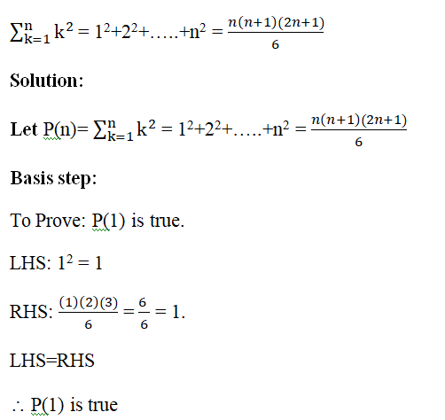
Problems
Prove by induction,

Slide 65
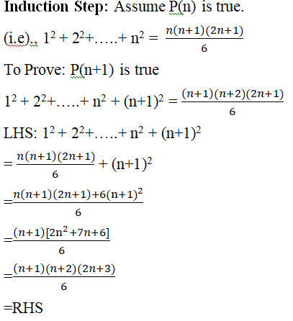

Slide 66

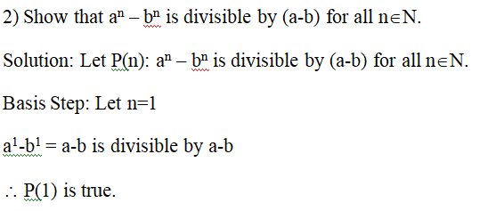
∴ P(n+1) is true.
If P(n) is true, then P(n+1) is also true.
By the principle of Mathematical Induction,

Slide 67
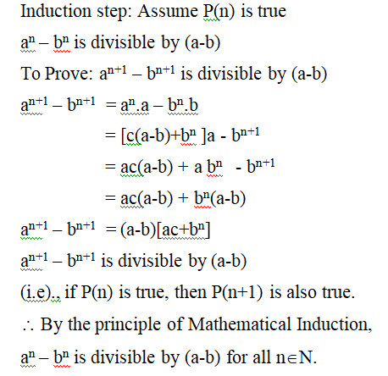

Slide 68
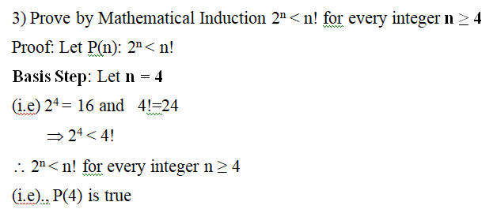

Slide 69
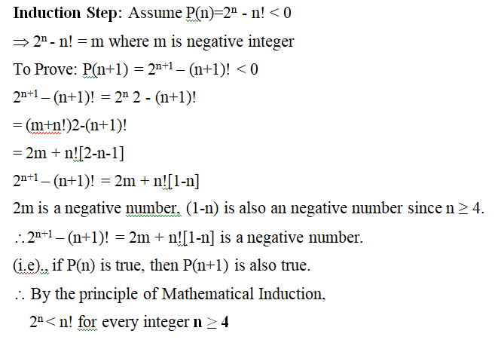

Slide 70
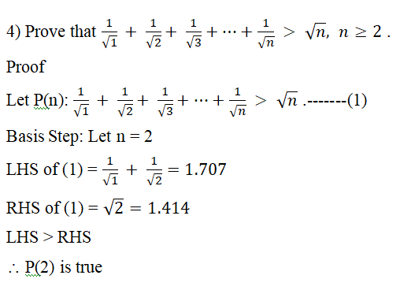

Slide 71
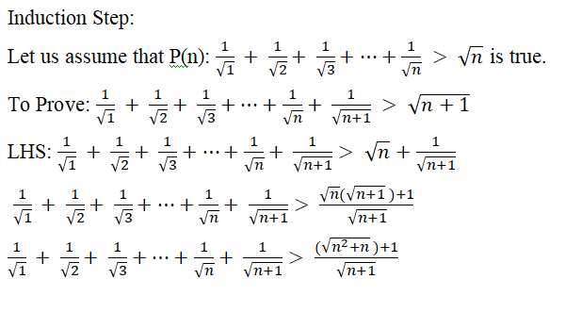

Slide 72
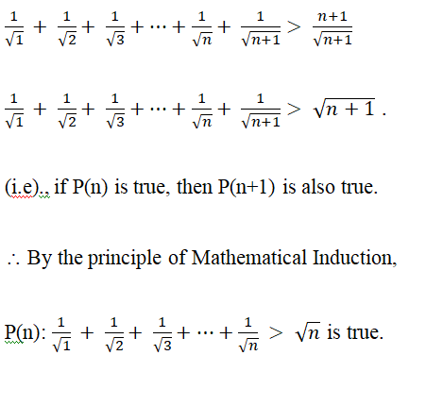

Slide 73
Thank you

